Slide 1
Detection vs Tracking
No computer has ever been designed that is ever aware of what it is doing; but most of the time, we aren’t either – Marvin Minsky
A Computer Vision Approach
Jorge Martinez Gomez Msc.

Slide 2
Computer vision
300 hours of video are uploaded to YouTube every minute
-Fortunelord statistics

Slide 3
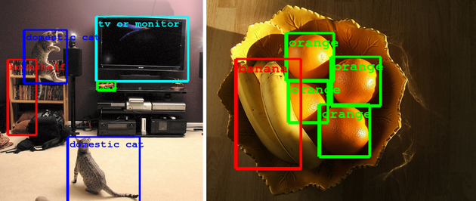
What is object detection?
Karpathy, A., et al. Large-scale video classification with convolutional neural networks. In Proceedings of the IEEE conference on Computer Vision and Pattern Recognition

Slide 4
Object detection

Slide 5
Training phase
Haar features | Integral Image | Adaboost | Cascading
Testing phase
Cascade trainer
Classifier cascade framework
Training
Set
(sub-windows)
Integral
Representation
Strong Classifier 1
(cascade stage 1)
Feature
computation
Strong Classifier 2
(cascade stage 2)
AdaBoost
Feature Selection
FACE IDENTIFIED
Strong Classifier N
(cascade stage N)
Slide courtesy: Kostantina Palla, University of Edinburgh
Slide courtesy: Kostantina Palla, University of Edinburgh
Notes:
בשר המאמר מתחיל בעצם עכשיו – עד עכשיו הדגמה.

Slide 6
What is object tracking?
The goal of visual object tracking is to estimate the state of a target in an image sequence.

Slide 7
What is object tracking?
Online tracking benchmark (2013) shows that each tracking algorithm performs best under particular circumstances.

Slide 8
Object Tracking
Tracking methods can be classified into two main categories:
Offline fashion: Search of objects on each frame.
One-shot learning: Learn object appearance model and update on each frame.

Slide 9
Offline tracking

Slide 10
Common failures
False positives
Object appearance variation
Occlusions

Slide 11
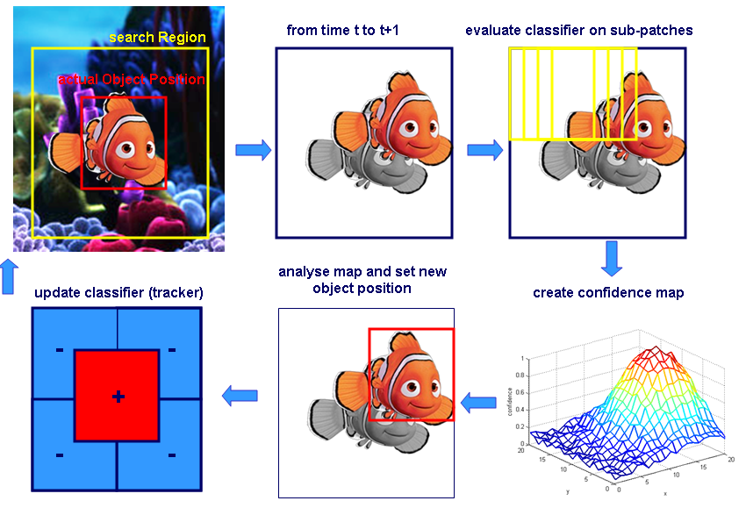
Online learning model
Semi-supervised On-line Boosting for Robust Tracking H. Grabner, C. Leistner, and H. Bischof In Proceedings European Conference on Computer Vision
(ECCV), 2008

Slide 12
And know what….
Tracking-by-detection methods use a previously trained model appearance of an object.
They search for an instance of a general class object.
Online trackers learn frame by frame the changes and variations of the appearance of an object.
However, they have to be manually initialized!. Also, when the object that is tracked is lost because of normal tracking scenarios (i.e. drifting)….the tracker is lost.
Why not combining them?

Slide 13
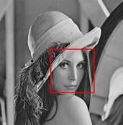
Dynamic object predictor
Object Detector
Prediction
$${\hat{x}}_{t|t−1}$$
Prediction
𝑥 ̂_(𝑡|𝑡−1)
Detections
$X_{t}$={$x_{1}, x_{2}, …, x_{n}$}
Detections
𝑋_𝑡={𝑥_1, 𝑥_2, …, 𝑥_𝑛}
$$x_{t+1}=x_{t}+ v_{t}+N(0;Q_{x})$$
$$v_{t+1}=v_{t} +N\left(0;Q_{v}\right)$$
$$s_{t+1}=s_{t } +N(0;Q_{s})$$
Yes
Add observation to dynamic model
Update template
Is detection consistent with prediction?
Low level tracking
No
$$\overline{x}=\min_{x_{i }∈X_{t }}\left\|{\hat{x}}_{t|t−1} −x_{i }\right\|$$
$\left\|{\hat{x}}_{t|t−1} −\overline{x}\right\|< ∝$

Slide 14
Dynamic object predictor
Object Detector
Prediction
$${\hat{x}}_{t|t−1}$$
Prediction
𝑥 ̂_(𝑡|𝑡−1)
Detections
$X_{t}$={$x_{1}, x_{2}, …, x_{n}$}
Detections
𝑋_𝑡={𝑥_1, 𝑥_2, …, 𝑥_𝑛}
$$x_{t+1}=x_{t}+ v_{t}+N(0;Q_{x})$$
$$v_{t+1}=v_{t} +N\left(0;Q_{v}\right)$$
$$s_{t+1}=s_{t } +N(0;Q_{s})$$
Yes
Add observation to dynamic model
Update template
Is detection consistent with prediction?
Low level tracking
No
$$\overline{x}=\min_{x_{i }∈X_{t }}\left\|{\hat{x}}_{t|t−1} −x_{i }\right\|$$
$\left\|{\hat{x}}_{t|t−1} −\overline{x}\right\|< ∝$

Slide 15
Dynamic object predictor
Object Detector
Prediction
$${\hat{x}}_{t|t−1}$$
Prediction
𝑥 ̂_(𝑡|𝑡−1)
Detections
$X_{t}$={$x_{1}, x_{2}, …, x_{n}$}
Detections
𝑋_𝑡={𝑥_1, 𝑥_2, …, 𝑥_𝑛}
$$x_{t+1}=x_{t}+ v_{t}+N(0;Q_{x})$$
$$v_{t+1}=v_{t} +N\left(0;Q_{v}\right)$$
$$s_{t+1}=s_{t } +N(0;Q_{s})$$
Yes
Add observation to dynamic model
Update template
Is detection consistent with prediction?
Low level tracking
No
$$\overline{x}=\min_{x_{i }∈X_{t }}\left\|{\hat{x}}_{t|t−1} −x_{i }\right\|$$
$\left\|{\hat{x}}_{t|t−1} −\overline{x}\right\|< ∝$

Slide 16
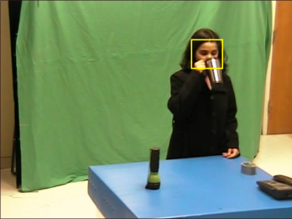
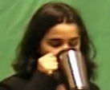
Low level tracking
On each frame, we make an object template T, and we apply normalized cross correlation (template matching)
Spefifically, it is applied around a window closed to position prediction ${(\hat{x}}_{t|t−1}$)
Template.
Correlation window
Best score

Slide 17
Recovery from previous problems
False positives
Object appearance variation
Occlusions

Slide 18
Scalable approach
You can combine detectors and online trackers to improve performance!

Slide 19
Dynamic object predictor
Object Detector
Prediction
$${\hat{x}}_{t|t−1}$$
Prediction
𝑥 ̂_(𝑡|𝑡−1)
Detections
$X_{t}$={$x_{1}, x_{2}, …, x_{n}$}
Detections
𝑋_𝑡={𝑥_1, 𝑥_2, …, 𝑥_𝑛}
Hog+SVM(Dalal-Triggs)
Adaboost
Alexnet
GoogleNet
LeNet
YOLOnet
Whatever finishes with Net. Trained for detection.
$$x_{t+1}=x_{t}+ v_{t}+N(0;Q_{x})$$
$$v_{t+1}=v_{t} +N\left(0;Q_{v}\right)$$
$$s_{t+1}=s_{t } +N(0;Q_{s})$$
Yes
Add observation to dynamic model
Update template
Is detection consistent with prediction?
Low level tracking
No
$$\overline{x}=\min_{x_{i }∈X_{t }}\left\|{\hat{x}}_{t|t−1} −x_{i }\right\|$$
$\left\|{\hat{x}}_{t|t−1} −\overline{x}\right\|< ∝$

Slide 20
Dynamic object predictor
Object Detector
Prediction
$${\hat{x}}_{t|t−1}$$
Prediction
𝑥 ̂_(𝑡|𝑡−1)
Detections
$X_{t}$={$x_{1}, x_{2}, …, x_{n}$}
Detections
𝑋_𝑡={𝑥_1, 𝑥_2, …, 𝑥_𝑛}
$$x_{t+1}=x_{t}+ v_{t}+N(0;Q_{x})$$
$$v_{t+1}=v_{t} +N\left(0;Q_{v}\right)$$
$$s_{t+1}=s_{t } +N(0;Q_{s})$$
Yes
KCF
MEEM
TemplateMatch
MeanShift
TLD
ASLA
Struck
SCM
Add observation to dynamic model
Update template
Is detection consistent with prediction?
Low level tracking
No
$$\overline{x}=\min_{x_{i }∈X_{t }}\left\|{\hat{x}}_{t|t−1} −x_{i }\right\|$$
$\left\|{\hat{x}}_{t|t−1} −\overline{x}\right\|< ∝$

Slide 21
Scalable approach

Slide 22
MultiObject Tracking

Slide 23
Summary
Object tracking methods are classified into two main categories: Tracking by detection methods, and one-shot learning trackers.
Tracking-by-detections use a general class object model in order to find instances of a given class (or classes).
Generic single object trackers are manually set at the beginning and tracks the object appearance for a single object.
Combination of two of these types of trackers improve performance.
https://github.com/JorgeMartinezG/KalmanTemplateTracker/blob/master/ktt.py

Slide 24
About me
Electronic engineer. mSc from Universidad del Norte (Barranquilla, Colombia).
Former researcher in Computer Vision (Stanford University).
Actually working at Piensa Labs in GIS and Machine Learning.
Also Lecturer of the Digital Image processing class since 2017 and new Artificial Intelligence class since this year! (Universidad del Norte)

Slide 25
Thank you!

